Slide 1
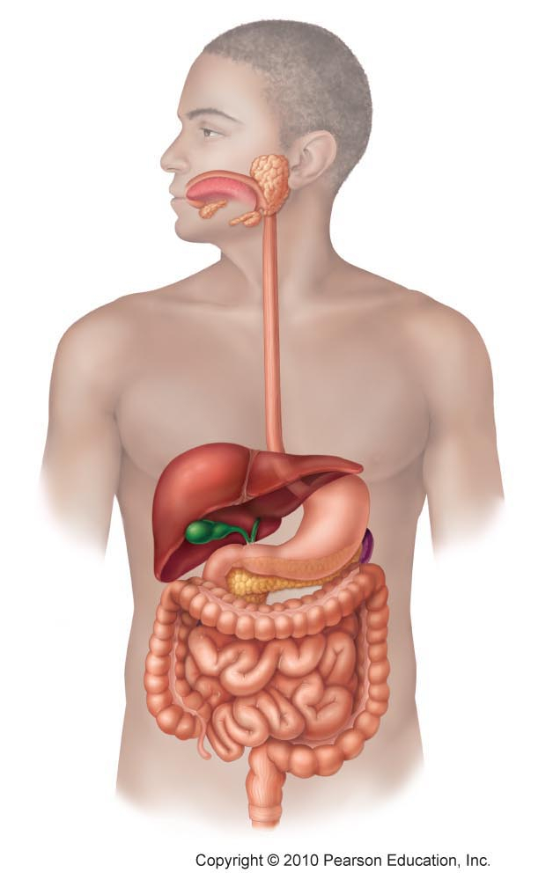
Daily Review
The Organs of the Digestive System
Name each organ in the digestive system.
A
B
C
D
G
H
E
F
I
J

Slide 2
Daily Review
Types of Digestion
Physical digestion is breaking down food into smaller pieces, for example chewing, without changing the chemical structure of the food
Chemical digestion uses chemicals, called enzymes, to break down the chemicals in the food
Think, Pair, Whiteboard, Share: How are physical and chemical digestion similar?
Think, Pair, Whiteboard, Share: How are the two types of digestion different?

Slide 3
Daily Review
Support Organs in the Digestive System
The gall bladder, liver and pancreas are part of the digestive system, but not the digestive tract.
What is the function of the gall bladder?
What is the function of the liver and pancreas?

Slide 4
Respiratory System

Slide 5
Learning Objectives
CFU
What are we going to learn?
Identify organs in the respiratory system
Describe the function of each organ in the respiratory system
Activate Prior Knowledge
There are many systems of organs in the human body.
Match the system of organs to what it is responsible for:
Digestion Excretory
Removing waste Respiratory
Controlling movement Digestive
Providing the body with oxygen Musculoskeletal

Slide 6
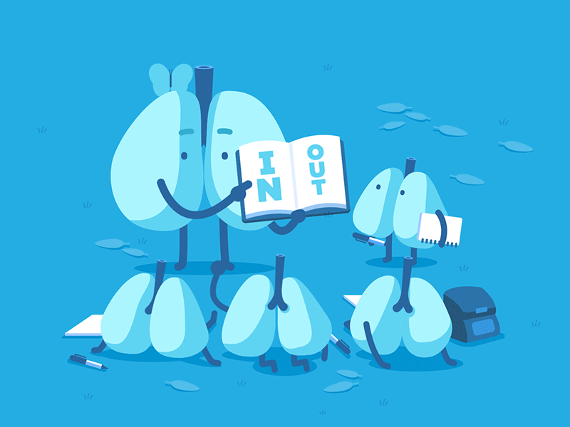
Concept Development
CFU 1
What is the respiratory system responsible for?
Vocabulary
Inhale: breathe in Exhale: breathe out
The Respiratory System
The respiratory system is responsible for exchanging gases with our environment.
Air is inhaled through the nose.
Oxygen is extracted from the air into the blood and replaced with carbon dioxide.
Air is then exhaled through the nose.
CFU 2
Which two gases are exchanged?
CFU 3
How is inhalation different to exhalation?

Slide 7
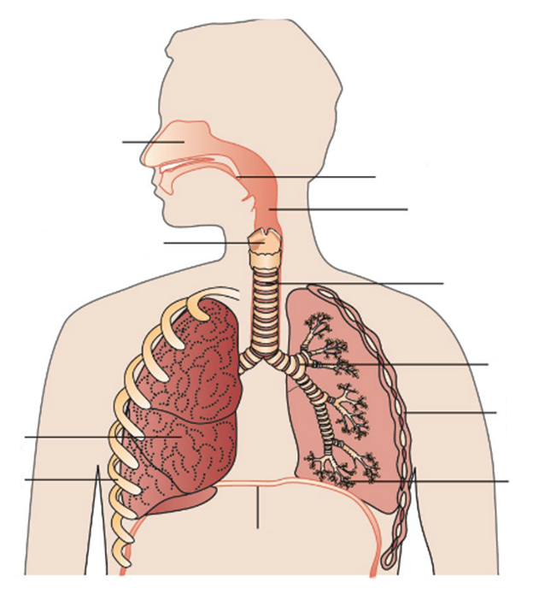
Concept Development
CFU 1
What is the respiratory tract?
CFU 2
How does air get into the respiratory system?
The Respiratory System – Respiratory Tract
The respiratory tract is the path the air passes through within the body.
Air is inhaled into the nasal cavity through the nostrils.
Air then goes through the pharynx and larynx (voice box), and down the trachea.
Nasal cavity
Pharynx
Larynx
Trachea
CFU 3
Which two organs does air go through before it reaches the trachea?
Vocabulary
Inhale: breathe in Exhale: breathe out

Slide 8
Concept Development
CFU 1
When the trachea splits, what does it become?
CFU 2
How are bronchioles different to the bronchi?
The Respiratory System – Respiratory Tract
The trachea splits into two bronchi (plural), which enter the lungs.
In the lungs, each bronchus (singular) splits into smaller and smaller tubes, called bronchioles.
Air sacs called alveoli are at the ends of each bronchiole.
Nasal cavity
Pharynx
Larynx
Trachea
Bronchus
Lung
Alveoli
CFU 3
What are at the ends of each bronchiole?
Vocabulary
Inhale: breathe in Exhale: breathe out

Slide 9
Concept Development
CFU 1
What is the epiglottis?
The Respiratory System – Support Organs
The epiglottis is a flap of cartilage at the back of the throat. It stops food entering the trachea
and closes over when we swallow.
Nasal cavity
Epiglottis
Pharynx
Larynx
Trachea
Bronchus
Intercostal Muscles
Lung
Ribs
Alveoli
Diaphragm
Vocabulary
Inhale: breathe in Exhale: breathe out

Slide 10


Slide 11
Skill Development
CFU 1
What is the function of the nasal cavity?
CFU 2
How is the function of the pharynx, trachea and bronchi similar?
The Function of Organs in the Respiratory System
The nasal cavity warms and moistens the air.
The pharynx, trachea and bronchi carry air into the lungs.
Air passing through the larynx allows you to speak.
CFU 3
What could you not do without the larynx?
Nasal cavity
Epiglottis
Pharynx
Larynx
Trachea
Bronchus
Intercostal Muscles
Lung
Ribs
Alveoli
Diaphragm
Vocabulary
Inhale: breathe in Exhale: breathe out

Slide 12
Relevance
Knowing how organs work together in a system and how the systems interact with each other will help you understand how the body works.
Understanding the structure and function of the respiratory system will help you understand how our bodies get oxygen and remove carbon dioxide.

Slide 13
Skill Closure
Put the organs of the respiratory tract in the correct order.
Bronchiole, nasal cavity, alveoli, trachea, pharynx, bronchus
Skill Closure
The intercostal muscles and the diaphragm are not part of the respiratory tract, but have a role in breathing. What is their role?
Skill Closure
What role do the alveoli and blood vessels play in the respiratory system?

Slide 14
Independent Practice
Collect and complete a hard copy of the respiratory system worksheet.
Breathing
The lungs have no muscles, so cannot move on their own.
Breathing occurs when the diaphragm and intercostal muscles work together.
The muscles contract to expand the chest and draw air into the lungs.
When the muscles relax, the chest deflates and pushes air out of the lungs.
The nasal cavity warms and moistens the air.
The pharynx, trachea and bronchi carry air into the lungs.
Air passing through the larynx allows you to speak.
The alveoli exchange oxygen and carbon dioxide.
They are surrounded by a mesh of tiny blood vessels.
Oxygen moves into the blood and carbon dioxide moves out of the blood.
The epiglottis is a flap of skin at the back of the throat. It stops food entering the trachea.
The ribs form a protective cage around the lungs.

